Slide 1

Pointers to structures and functions
L35

Slide 2
Objectives
To learn and appreciate the following concept
Pointers and Character Strings
Pointers and 2D
Array of Pointers
Pointers and Structures
Pointers and functions

Slide 3
Session outcome
At the end of session one will be able to understand
Pointers and Character Strings
Pointers and 2D
Array of Pointers
Pointers and Structures
Pointers and functions

Slide 4
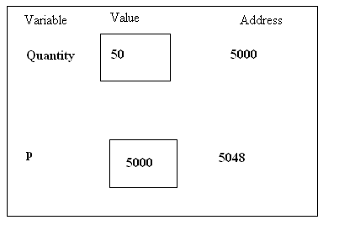
Pointers- recap
int Quantity; //defines variable Quantity of type int
int* p; //defines p as a pointer to int
p = &Quantity; //assigns address of variable Quantity to pointer p
Now…
Quantity = 50;//assigns 50 to Quantity
*p = 50; //assigns 50 to Quantity

Slide 5
Pointers and arrays
When an array is declared, the compiler allocates a base address and sufficient amount of storage to contain all the elements of the array in contiguous memory locations.
The base address is the location of the first element (index 0) of the array.
The compiler also defines the array name as a constant pointer to the first element.

Slide 6
Problems…
Write programs using pointers to compute
Exchange two values (values stored in variables x & y).
Sum of all elements stored in an integer array.

Slide 7
Exchanging two values
void main(){
int x, y, t,*a,*b;
a=&x; b=&y;
cin>>*a>>*b; // equivalent to cin>>x>>y;
t=*a;
*a=*b;
*b=t;
cout<<“x=“<<x;
cout<<“y=”<<y;
}
Output:
x= 10 & y = 5
x= 5 y = 10

Slide 8
Sum of all elements stored in an array
void main() {
int *p, sum=0, j, i=0;
int x[5] ={5, 9, 6,3,7};
p=x;
while(i<5){
sum+=*p;
i++;
p++; }
cout<<“sum of elements =“<<sum;
}
Output:
Sum of elements =30

Slide 9
Pointers & Character strings
//length of the string
void main() {
char name[15];
char *cptr=name;
cin>>name;
while(*cptr!=‘ \0')
cptr++;
cout<<"length="<<cptr-name;
}
Output:
manipal
length= 7

Slide 10
Pointers & Character strings
The statements
char name[10];
char *cptr =name;
declares cptr as a pointer to a character and assigns address of the first character of name as the initial value.
The statement while(*cptr!=‘\0’)
is true until the end of the string is reached.
When the while loop is terminated, the pointer cptr holds the address of the null character [‘\0’].
The statement length = cptr – name; gives the length of the string name.

Slide 11
Pointers & Character strings
A constant character string always represents a pointer to that string.
The following statements are valid.
char *name;
name =“Delhi”;
These statements will declare name as a pointer to character array and assign to name the constant character string “Delhi”.

Slide 12
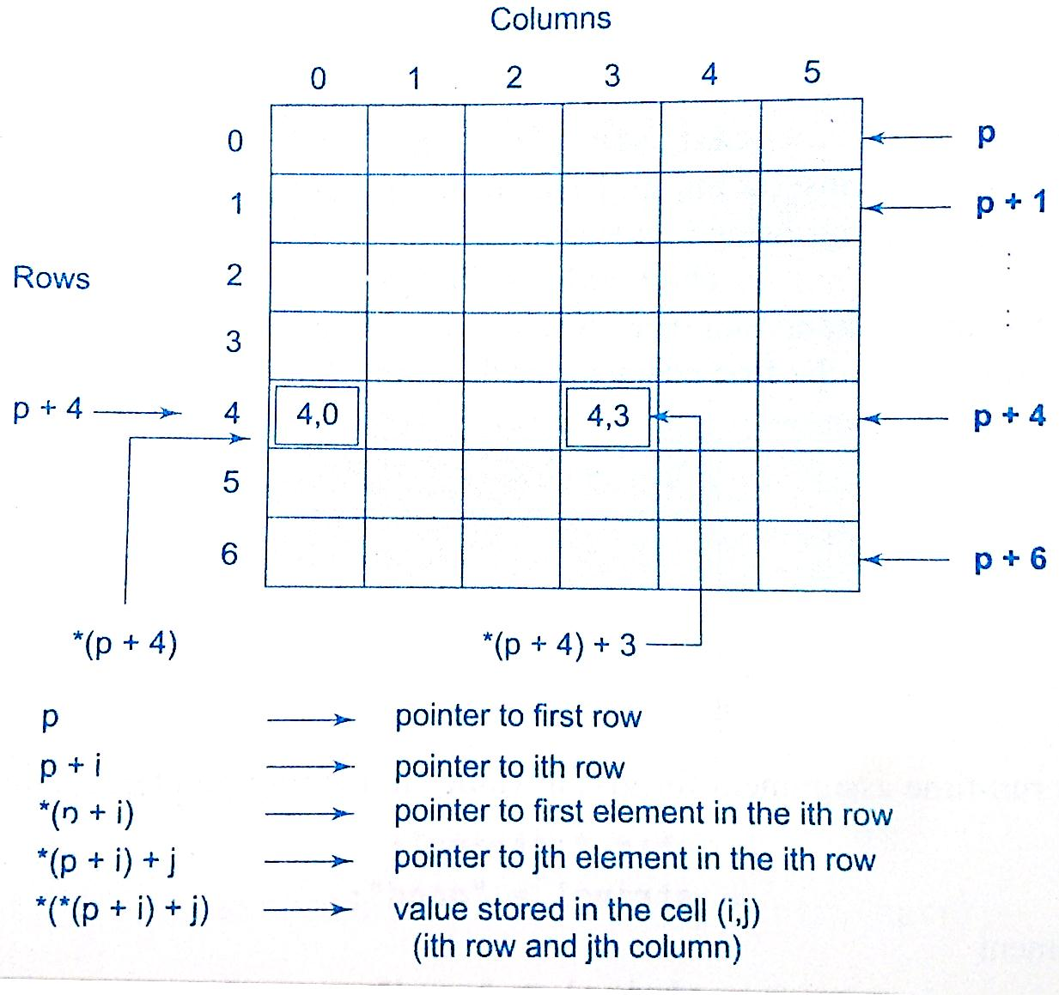
Pointers and 2D arrays
int a[][2]={ {12, 22},
{33, 44} };
int (*p)[2];
p=a; // initialization
Element in 2d represented as
*(*(a+i)+j)
or
*(*(p+i)+j)

Slide 13
Pointers and 2D arrays
// 2D array accessed with pointer
#include <iostream.h>
void main(){
int i,j,(*p)[2], a[][2]={{12, 22},
{33, 44} };
p=a;
for(i=0;i<2;i++){
for(j=0;j<2;j++)
cout<< *(*(p+i)+j)<<"\t";
cout<<"\n";
}
}
Output:
12 22
33 44

Slide 14
Array of pointers
We can use pointers to handle a table of strings.
char name[3][25];
name is a table containing 3 names, each with a maximum length of 25 characters (including ‘\0’)
Total storage requirement for name is 75 bytes.
But rarely all the individual strings will be equal in lengths.
We can use a pointer to a string of varying length as
char *name[3] = { “New Zealand”, “Austrailia”, “India” };

Slide 15
Array of pointers
So , char *name[3] = { “New Zealand “,
“Australia”,
“India”};
Declares name to be an array of 3 pointers to characters, each pointer pointing to a particular name.
name[0] → New Zealand
name[1]→ Australia
name[2]→ India
This declaration allocates 28 bytes.

Slide 16
Array of pointers
The following statement would print out all the 3 names.
for(i=0; i<=2;i++)
cout<<name[i]; or *(name + i);
To access the j^{th} character in the i^{th} name, we
may write as
*(name[i] +j)
The character array with rows of varying lengths are called ragged arrays and are better handled by pointers.

Slide 17
Pointers and structures
Consider the following structure
struct inventory {
char name[30];
int number;
float price;
} product[2],*ptr;
This statement declares product as an array of 2 element, each of the type struct inventory.
ptr=product; assigns the address of the zero^{th} element of product to ptr
or ptr points to product[0];

Slide 18
Pointers and Structures
Its members are accessed using the following notation
ptr →name
ptr →number
ptr →price
The symbol → is called arrow operator (also known as member selection operator)
When ptr is incremented by one, it points to the next record. i.e. product[1]
The member number can also be accessed using
(*ptr).number
Parentheses is required because ‘.’ has higher precedence than the operator *

Slide 19
Pointers and Structures- example
struct invent
{
char name[30];
int number;
float price;
};
void main() {
struct invent prod[3], *ptr;
for(ptr = prod; ptr < prod+3; ptr++)
cin>>ptr →name>>ptr →number>>ptr →price;
ptr=prod;
while(ptr < prod+3)
{
cout<<ptr →name<<”\n”<<ptr →number<<“\n”<<ptr →price;
ptr++;
}}

Slide 20
Pointers as functions arguments
When we pass addresses to a function, the parameters receiving the addresses should be pointers.
void change (int *);
void main( ) {
int x = 20;
change(&x);
cout<<“x after change:-”<< x;
}
void change (int *p)
{
*p = *p + 10 ;
}
Output:
x after change:- 30

Slide 21
Pointers as function arguments
When the function change() is called, the address of the variable x, not its value , is passed into the function change().
Inside change(), the variable p is declared as a pointer and therefore p is the address of the variable x. The statement
*p=*p +10 adds 10 to the value stored at the address p. Since p represents the address of x, the value of x is changed from 20 to 30. therefore it prints 30.

Slide 22
Function returning pointer
A function can return single value by its name or return multiple values through pointer parameters.
int *larger (int *x, int *y)
{
if (*x > *y)
return (x);
else
return(y);
}
int *larger (int *, int *);
void main()
{
int a=10, b=20, *p;
p=larger (&a, &b);
cout<<*p;
}

Slide 23
Pointers to Functions
A function, like a variable has a type and an address location in the memory.
It’s therefore possible to declare a pointer to a function, which can then be used as an argument in another function.
A pointer to a function is declared as:
type (*fptr) ();
This tells the compiler that fptr is a pointer to a function, which returns type value. The parentheses around *fptr are necessary.

Slide 24
Pointers to Functions
We can make a function pointer to point to a specific function by simply assigning the name of the function to the pointer.
e.g:
double mul (int, int);
double (*p1)();
p1=mul;
declares p1 as a pointer to a function and mul as a function and then make p1 to point to the function mul.
To call the function mul, we may use the pointer p1 with the list of parameters.
i.e.
(*p1)(x, y); //Function call equivalent to mul(x, y);

Slide 25
Invoking Function using pointer to a Function
void display (); //fn prototype
void main()
{
void (*ptr)();//declaration
ptr=display; //initialization
(*ptr)(); //function call
}
void display()
{
cout<<“Pointers is fun”;
}
Output:
Pointers is fun
Notes:
Using Pointers :
Advantages
Pointers provide direct access to memory.
Pointers provide a way to return more than one value to the functions.
Reduces the storage space and complexity of the program.
Reduces the execution time of the program.
Provides an alternate way to access array elements
Pointers can be used to pass information back and forth between the calling function and called function.
Disadvantages
Uninitialized pointers might cause segmentation fault.
Dynamically allocated block needs to be freed explicitly. Otherwise, it would lead to memory leak.
Pointers are slower than normal variables.
If pointers are updated with incorrect values, it might lead to memory corruption.

Slide 26
Benefits(use) of pointers
Pointers provide direct access to memory.
Pointers provide a way to return more than one value to the functions.
Reduces the storage space and complexity of the program.
Reduces the execution time of the program.
Provides an alternate way to access array elements
Pointers can be used to pass information back and forth between the calling function and called function.

Slide 27
Drawbacks of pointers
Uninitialized pointers might cause segmentation fault.
Dynamically allocated block needs to be freed explicitly. Otherwise, it would lead to memory leak.
Pointers are slower than normal variables.
If pointers are updated with incorrect values, it might lead to memory corruption.

Slide 28
Summary
Pointers -recap
Pointers and Character Strings
Pointers and 2D
Array of Pointers
Pointers and Structures
Pointers and functions

